Slide 1
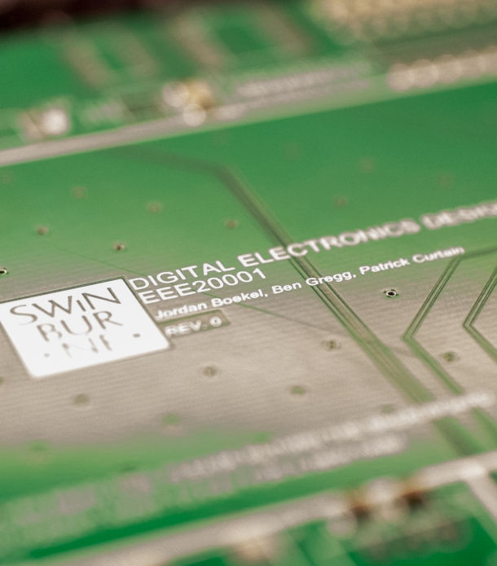
Integrated Design Project: EEE20001 Lab Equipment
Patrick Curtain, Jordan Boekel, Ben Gregg
Supervisor:
Peter O’Donoghue

Slide 2
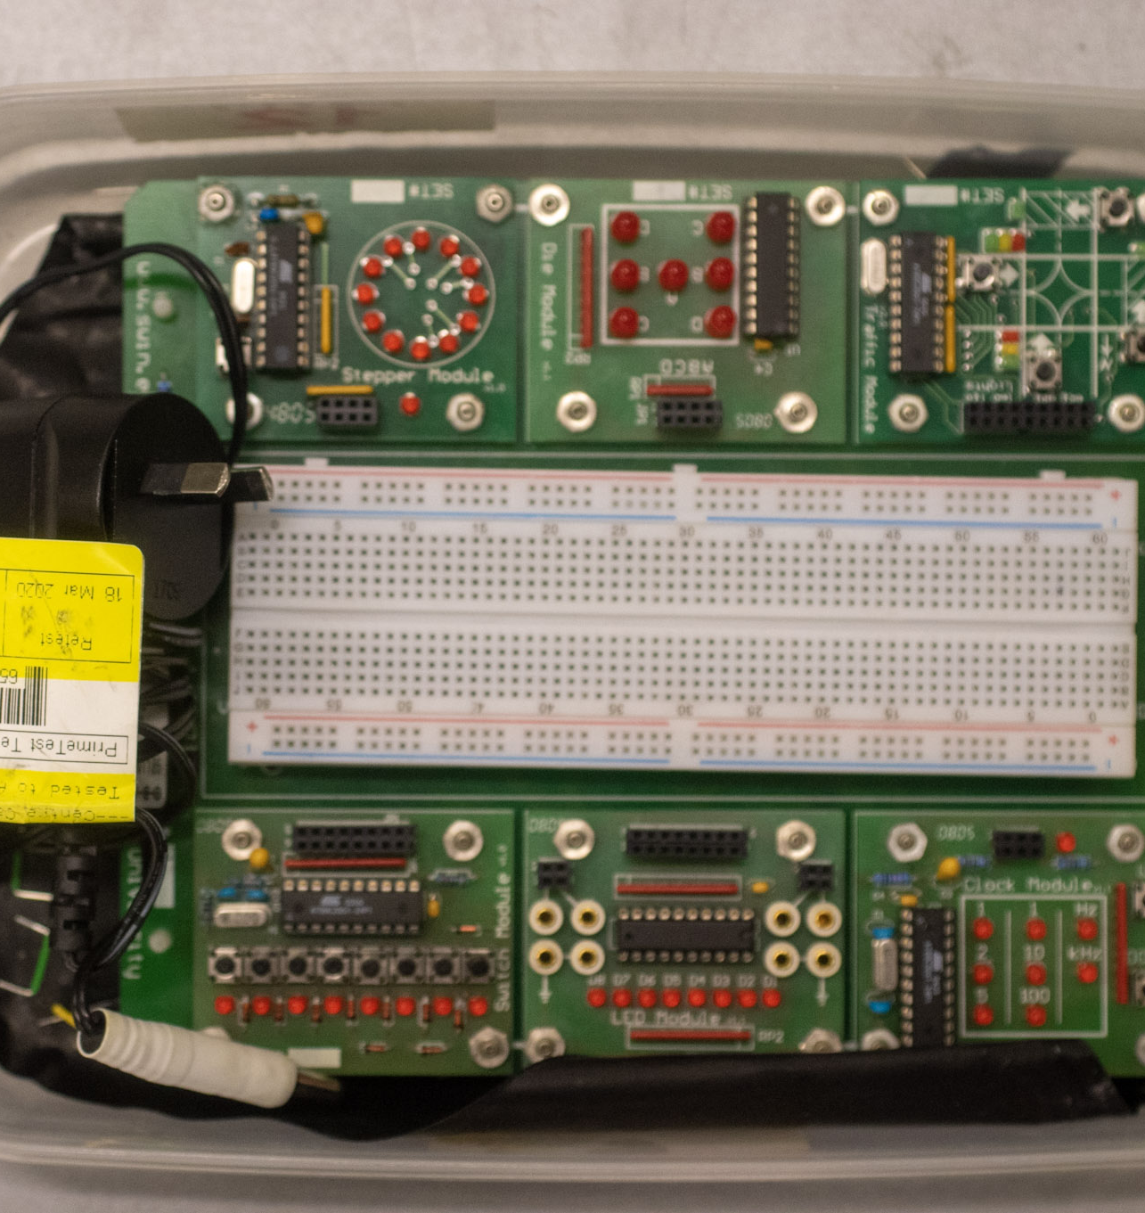
Problem Outline
To update and redesign the current EEE20001 student laboratory equipment.
Current equipment is old and nearing end of life. A new board is needed to continue and improve the learning experience for students.
Notes:
QuickStarter has created an outline to help you get started on your presentation. Some slides include information here in the notes to provide additional topics for you to research.

Slide 3
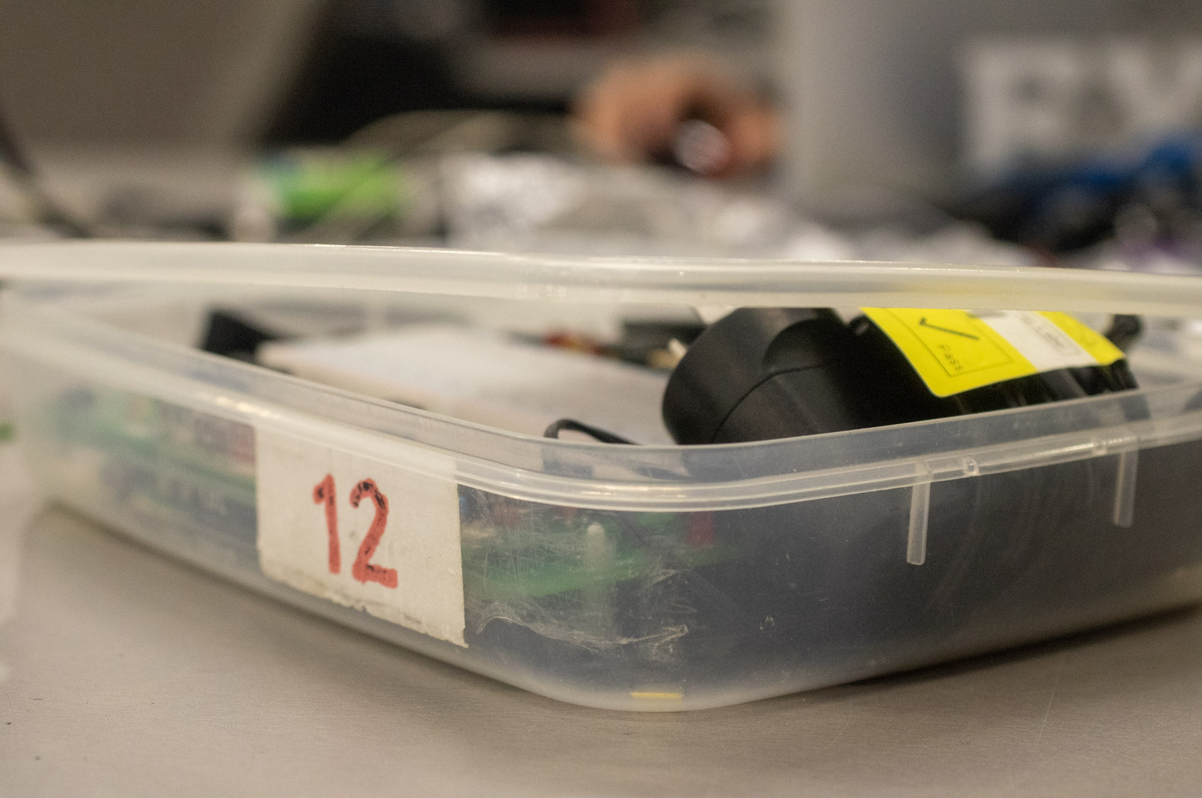
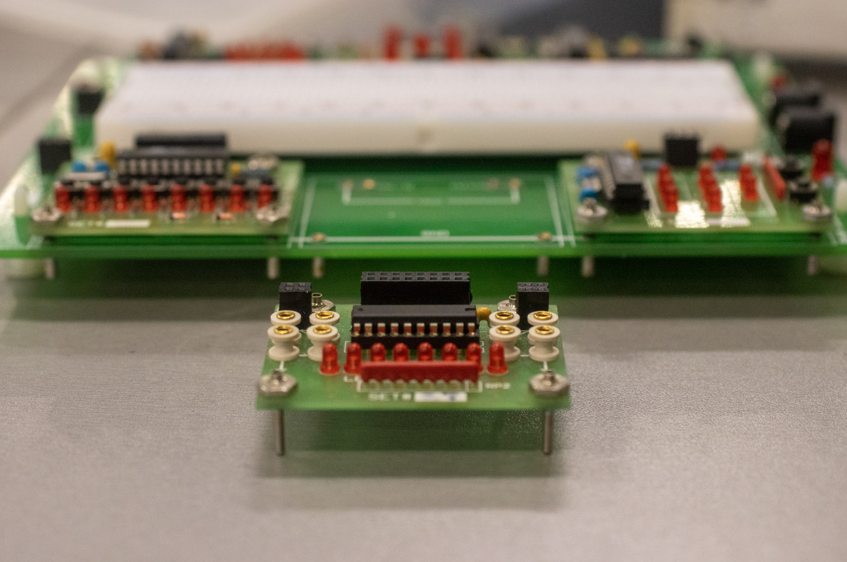
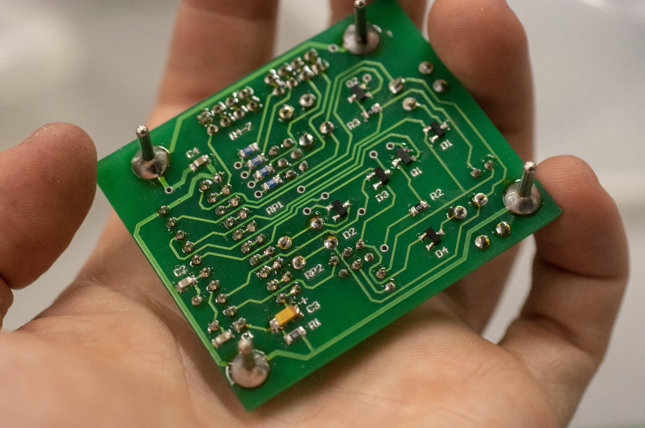
Current Equipment
Current Issues:
Old and “long in the tooth”
Size
External Power Supply Brick
Old through hole components
Expensive to manufacture

Slide 4






Traffic Module
Frequency Generator
Stepper
Simulates a traffic intersection, students provide a control system.
Provides a frequency output for students to use as a clock
Simulates the control scheme of a stepper given a sequence of inputs
Dice Module
LED Module
Fun Buttons
Provides an output buffer for students to view their CPLD state
Buttons for the student to provide input to experimental circuits
A digital dice display controlled by user inputs

Slide 5
Project Objectives
Reduce total board footprint
Use SMD components
Integrated Power Supply
Decrease Total Cost
Improve Usability
Additional features
USB C connector
Notes:
QuickStarter has created an outline to help you get started on your presentation. Some slides include information here in the notes to provide additional topics for you to research.

Slide 6
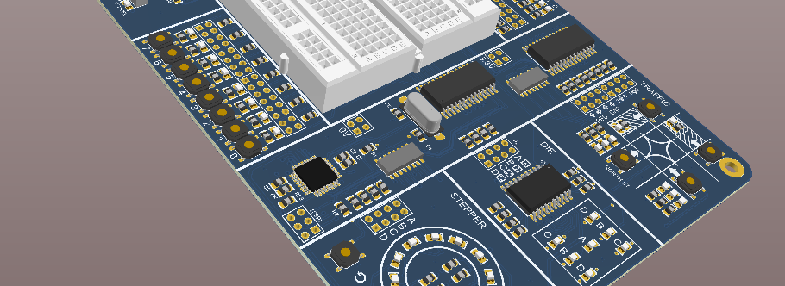
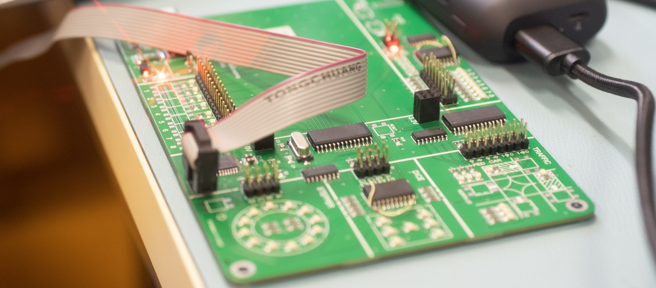
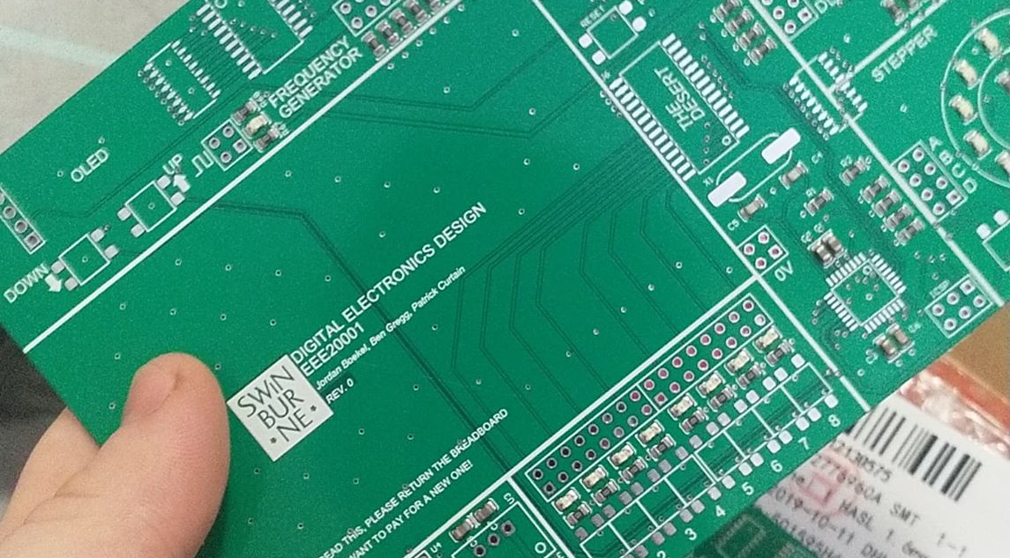
THE NEW DESIGN
Design Considerations
Single board design, rather than separate boards for modules.
Multi vs single micro-controllers
Bus Design (I2C)
Manual vs programmable debouncing
Multiplexing stepper
Linear vs Switch Regulator
SMT vs through hole components

Slide 7
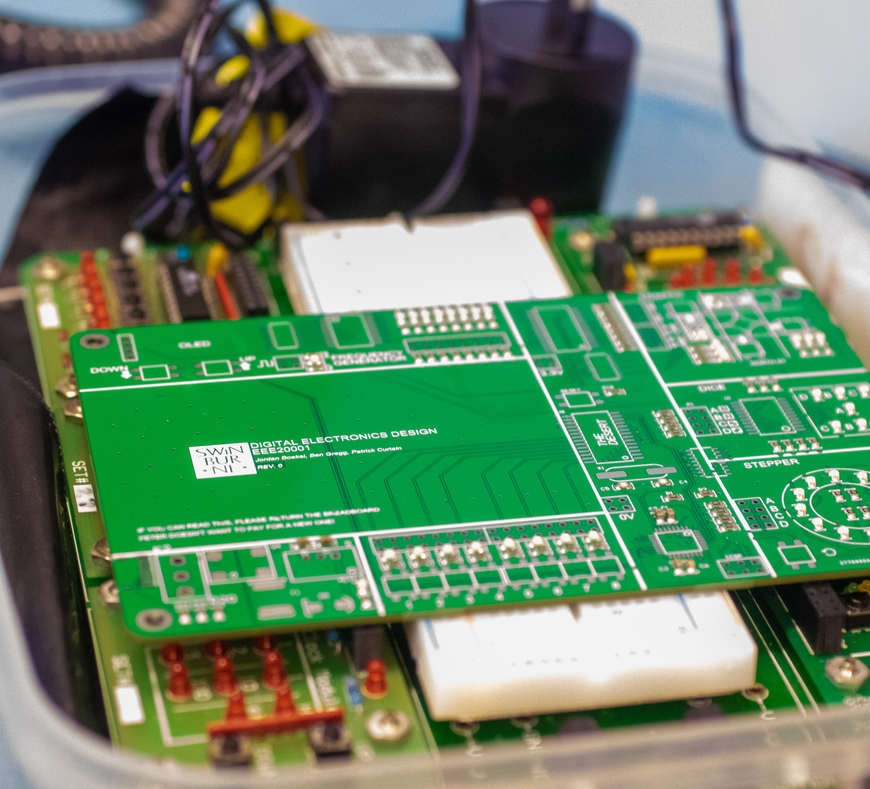
Smaller profile
~60% Reduction in area.
Reduced volume.
Cheaper to manufacture
Per board cost of ~$30-40 and minimal final assembly – 90% cost reduction.
Simpler to maintain and use.
One microcontroller to program
Less components
Powered by USB C.
OLED for frequency generator.

Slide 8
MCU research and software
Considered various MCU alternatives for the project
Decided on ATMega328 due to extensive ecosystem (Arduino) and lower cost hardware.
To deal with lack of GPIO, use I²C port expanders to provide more ports.
Using public libraries to reduce workload and implement functionality – OLED, Expander, debouncing
Provide a pin layout specification for PCB design
Implement In-circuit programming for embedding the processor in the design
Implement modules controlled by MCU in software

Slide 9
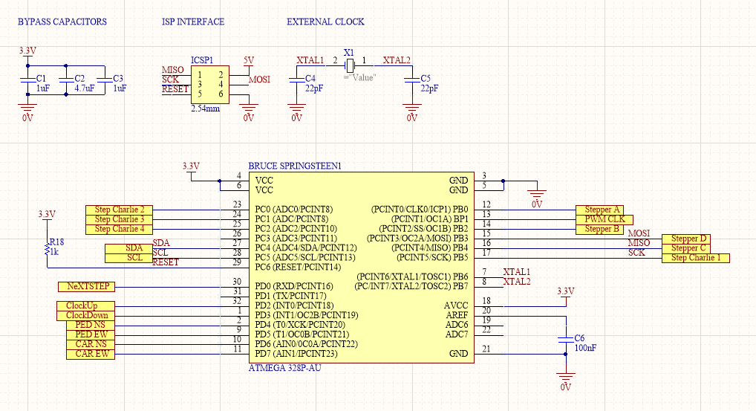

Slide 10
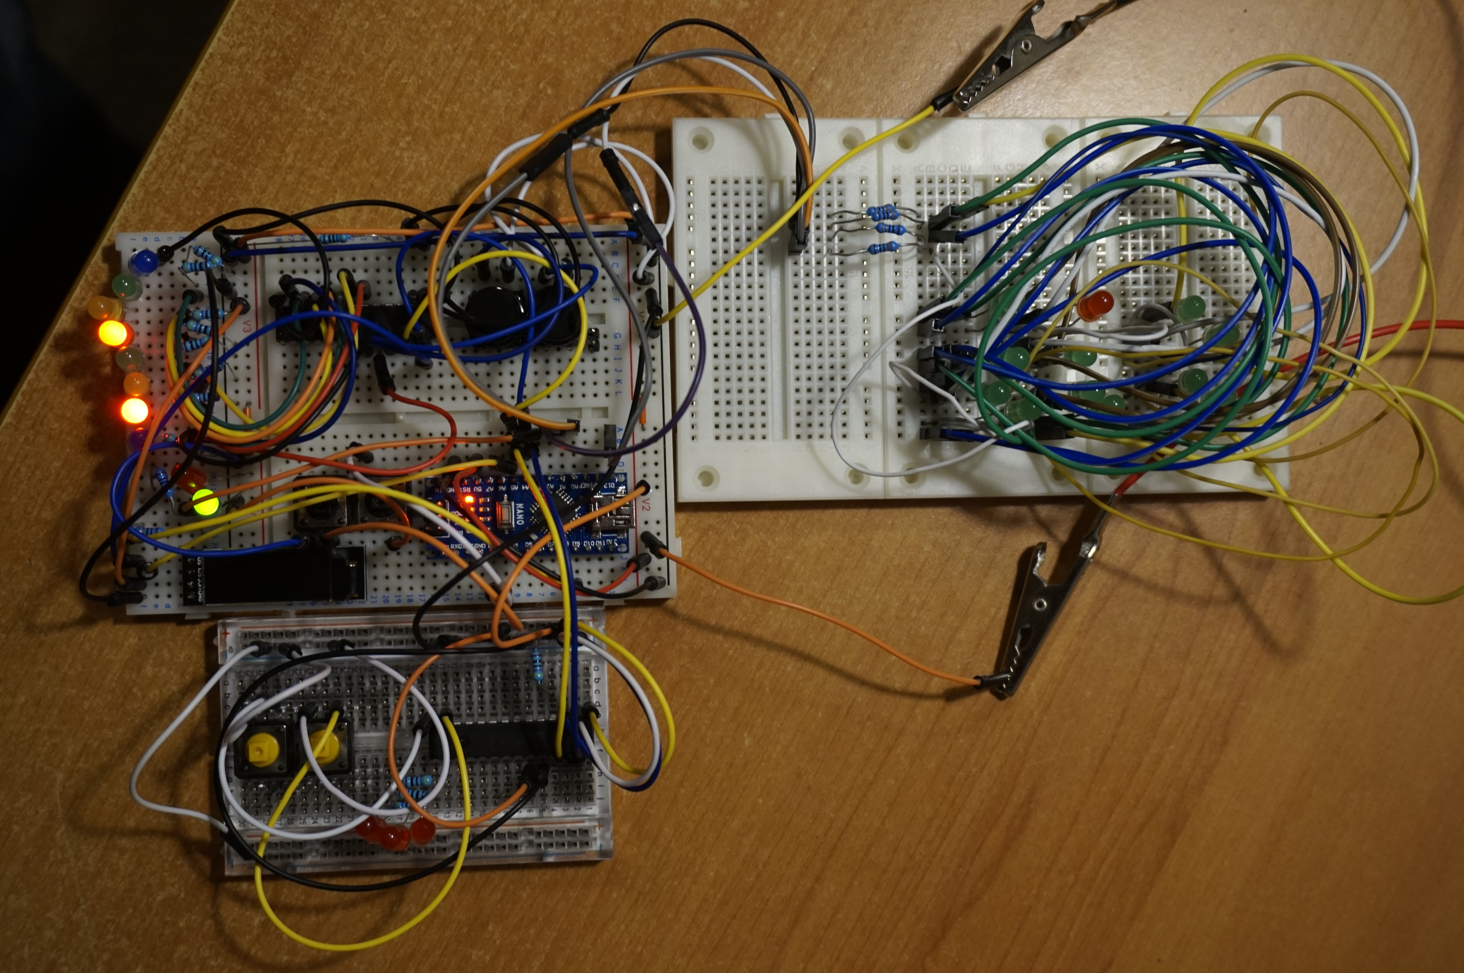
Design Hardware and Software Prototyping
Prototype the circuit on a breadboard to aid in design
Used an Arduino Nano development board
Tested each module in breadboard prototype before having PCB assembled
Create functional software to specification beforehand – can directly port to the finished product.

Slide 11
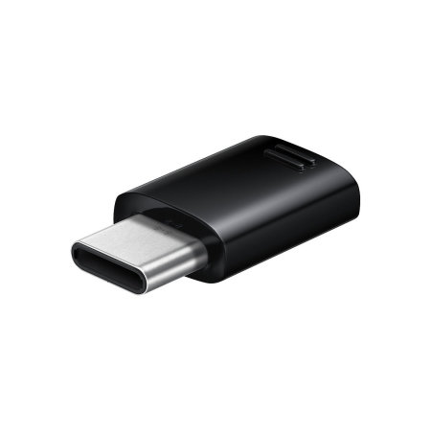
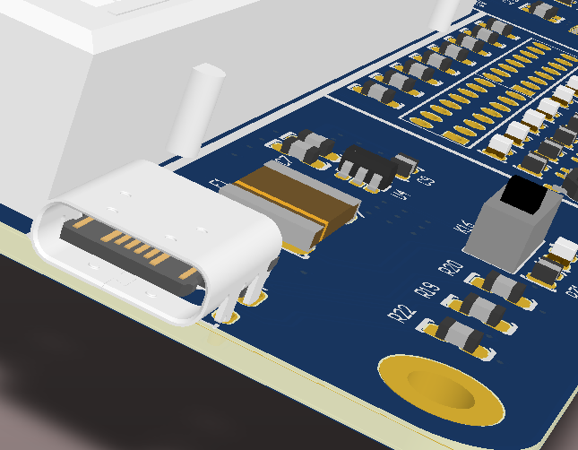
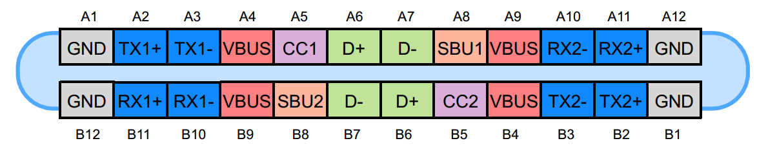
USB Protocol
The board now utilises modern USB C connectors
Personal devices can act as 5V supplies
For this specific design, the circuitry is made to identify the board as a ‘sink’ through the channel configuration pins
Programming through USB interface (Atmega8U2/16U chips etc provide usb to uart bridges)

Slide 12
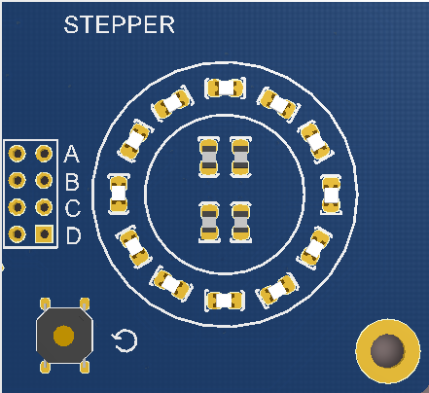
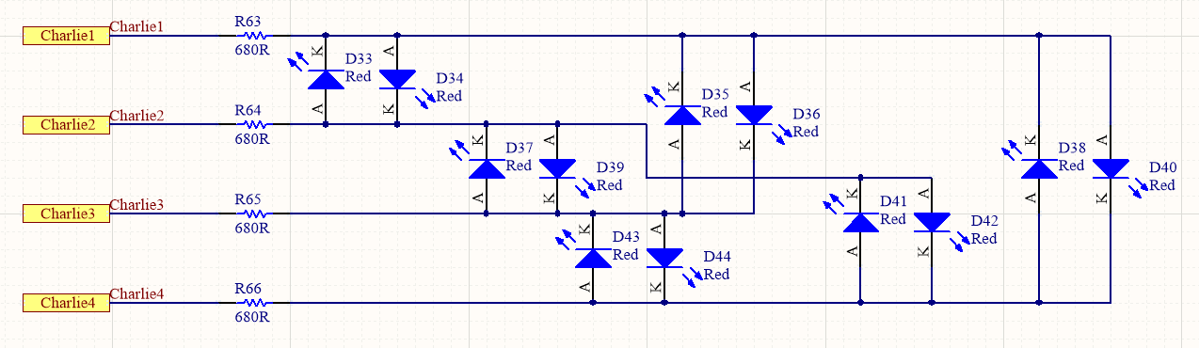
Stepper Design/ Software & Circuit Protection
Logic/design for controlling stepper motor
Multi-plex vs single driven
Bidirectional TVS, current limiters etc
Possible harm due to ESD events

Slide 13
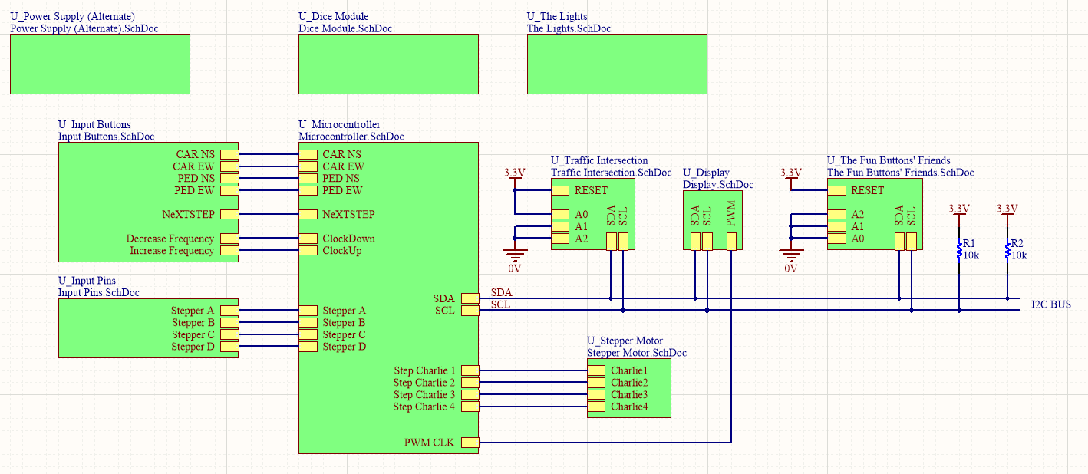
Dice and lights standalone entities
I2C bus common between the display, intersection, and button interface.
Stepper lights directly driven by MCU

Slide 14
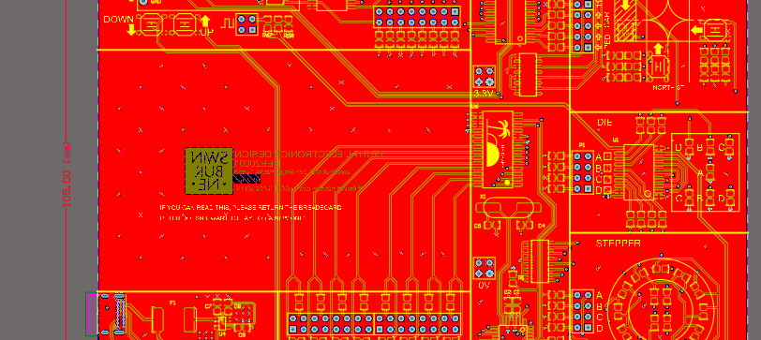
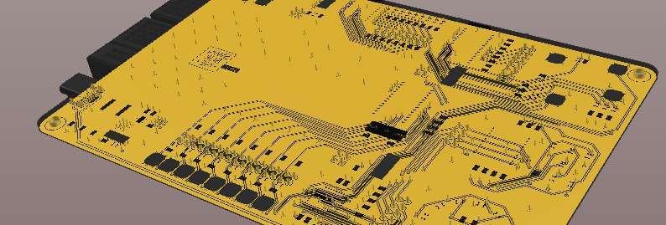
PCB Layout
Single Sided.
Four- layer design.
Designed to IPC 2221B Standard.
Adequately size tracks
Teardrop strain relief on pads
Minimized footprint to reduce cost and packaging concerns(105, 152mm).
As few through hole components as possible (3 Unique components)
Designed to make both hand soldering and automated assembly possible.
Symbols on silkscreen to assist in readability.

Slide 15
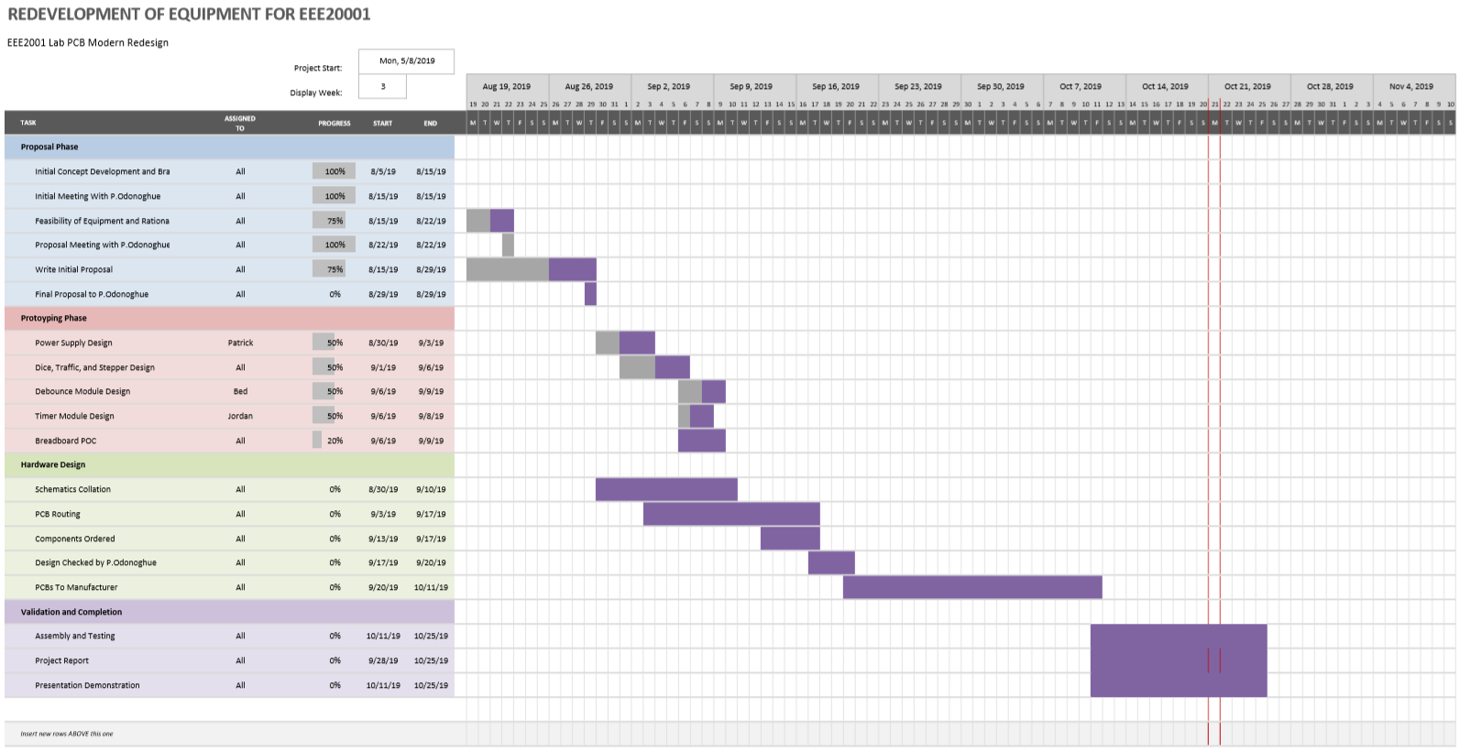
Management

Slide 16
Overall redesign changes
SMT topology
Single MCU controls all modules
USB-C power supply
Port expanders for GPIO
OLED screen for frequency generator
Assembly
Choosing components
Protection

Slide 17
Proposals for Future Iterations
Full SMT and automated assembly.
Improved aesthetic and better use of space.
Integration of serial programming into USB interface.
Better integration of OLED display.

Slide 18
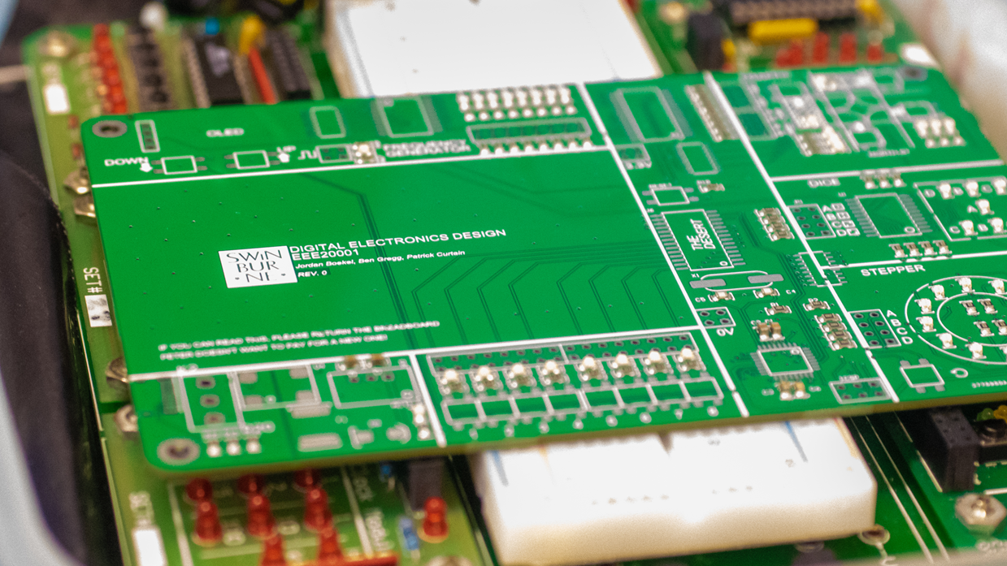
Outcome

Slide 19
Learning Outcomes
Engineering skills
Management
Designing for an embedded microcontroller.
PCB design
Component choices – Common is better!
PCB manufacture and assembly
Software programming of embedded systems
Project time management
Working with a client
Organising team tasks

